Slide 1
Patient Agency: a focus for integrated care
Mark Sullivan, MD, PhD
Psychiatry and Behavioral Sciences
Bioethics and Humanities
Anesthesiology and Pain Medicine

Slide 2
Agenda
1] Case study of integrating mental health care with chronic disease care
2] Reconsidering clinical goals
3] Reevaluating ethical guidance
No health without mental health

Slide 3
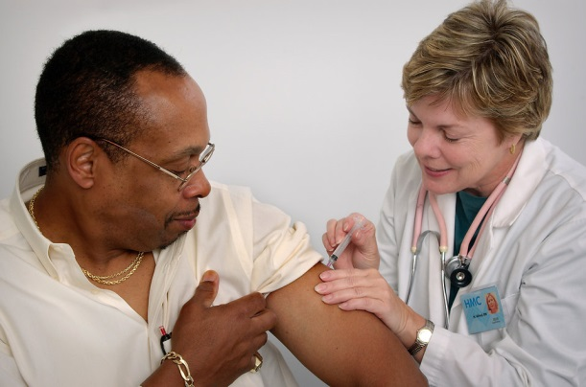
Case study: Darryl Thomas
47-year-old man with a 5-year history of T2D.
He missed his PCP appointment 3 mo. ago.
He complains of “out of control sugars.” His current hemoglobin A1C value of 8.7% is an increase from 7.4% only 6 months ago.
He asks to increase his gabapentin dose because he is having more burning neuropathy pain in his feet during the past 3 months.

Slide 4
Case study: Darryl Thomas
He seems more reserved than usual and is clearly frustrated by progressively worsening insomnia, fatigue, not enjoying his usual activities, weight gain, poor concentration.
He believes his pain is at the root of all his problems, but you are not sure. You suspect Darryl may be depressed.

Slide 5
Questions concerning Darryl
What are the goals for Darryl’s care?
Who chooses these?
How are depression-related and diabetes-related goals integrated?
Which therapies should be used for Darryl?
Who chooses these?
Can Darryl refuse or request specific therapies?
How do we decide when Darryl’s care has been successful?

Slide 6
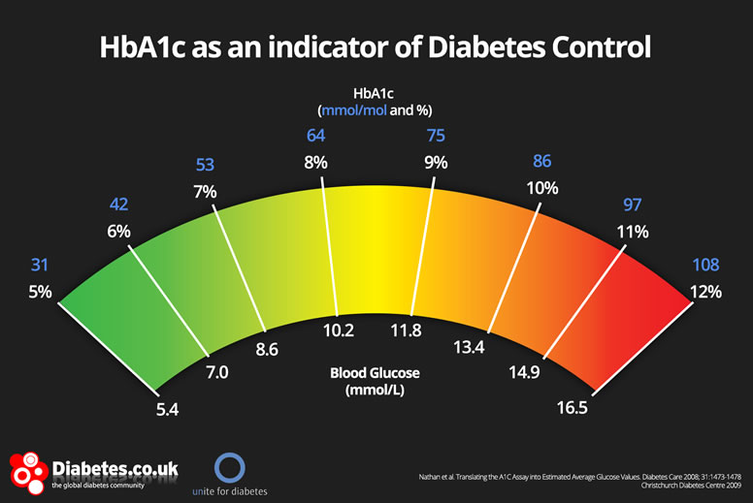
Reconsidering clinical goals: what are we aiming for with treatment?
Cure: “I want the illness to go away forever.”
Disease reduction: “get HbA1c below 7%”
Symptom remission: “pain < 5/10, PHQ9 < 5”
Patient satisfaction: “satisfied with my care”
Improved health: as measured by the above?

Slide 7
“No health without mental health” (Prince et al. Lancet, 2007)
“About 14% of the global burden of disease has been attributed to neuropsychiatric disorders…”
“The burden of mental disorders is likely to have been underestimated because of inadequate appreciation of the connectedness between mental illness and other health conditions. Because these interactions are protean, there can be no health without mental health.”
Notes:
The WHO proposition that there can be “no health without mental health” (2005) has also been endorsed by the Pan American Health Organisation, the EU Council of Ministers, the World Federation of Mental Health, and the UK Royal College of Psychiatrists.

Slide 8
Interactions between mental disorders and other health conditions
Mental disorders may increase rate of health cond.
Behavioral risks: inactivity, obesity, smoking…
Shared biological effects: cortisol, inflammation…
Common genetic and environmental risk factors
Health cond. may increase rate of mental disorder
Direct effects on brain
Psychological burden of chronic disease
Mental disorders may affect treatment and outcome
Delay help-seeking
Decrease adherence to medication, behavior change
Notes:
From Prince et al 2007

Slide 9
Reevaluating ethical guidance: how should we respect Darryl?
Bioethics: we respect Darryl as a person by respecting his autonomy
Autonomy = capacity for self-determination
Generally operationalized as informed consent
But isn’t this capacity precisely what is impaired in patients with mental disorders?
Do we have an obligation to restore or foster Darryl’s autonomy?
Decisional autonomy
Agency to do and be things of value

Slide 10
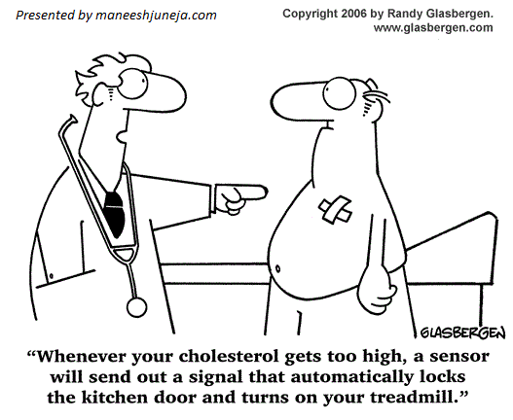
The modern medical dream: evading the non-compliant patient

Slide 11
Overall question:
How are we to understand and promote the patient’s participation in the production of health?

Slide 12
My argument about agency
Concept of health behavior retards integrated mental and physical health care
Who accomplishes “behavior change”?
We seek not just an patient activated for pursuit of clinician goals, but an autonomous patient who sets and pursues her own vital goals.
Patient agency is both the primary means and primary end of health care.

Slide 13
How are action and health related? extrinsic and intrinsic
Extrinsic: healthy action produces health- diet, exercise, medication adherence
Unavoidable in chronic illness care
BA and SA are central to integrated MH care
Intrinsic: meaningful action is an essential component of health: acting is being healthy
Can mitigate and retard progress of pathology
Organ impairments, activity restrictions, participation limitations– circular relationship
Notes:
Patients who intend to quit smoking have higher self-rated health, so do citizens who vote.
Lorraine at 95: loss of bridge partner → loss of social and physical activity → loss of physical and cognitive function, bone and brain mass

Slide 14
Progress in conception of health behavior
Past: Compliance, adherence
Provide information to obedient patient
Present: self-management of chronic illness
Provides skills in responsive system (CCM)
Patient goals=clinician goals (A1c, LDL, PHQ9)
Future: patient empowerment
patient’s vital goals → clinical goals
Focus on promotion of healthy action
Emphasize intrinsic rather than extrinsic motivation

Slide 15
Modern health psychology: patients become more active
From behavior to intentional action
Bandura: patients “are agents of experience rather than simply undergoers of experience.”
Shift from behavior reinforcers to confidence allowed advance from predicting to changing behavior
From confidence to personal importance motivational interviewing (MI)
elicit rather than instill motivation for change
move conflict between aspirations and actions inside the patient

Slide 16
Shared decision-making (SDM) “pinnacle of patient-centered care”
SDM vs. informed consent
Aim: promoting vs. respecting autonomy
Refusals: negotiated not simply honored
Role: part of care not prior to care
Application: “preference sensitive decisions”
Setting: chronic rather than acute care
Process: collaboration rather than permission
Focus: goals rather than means

Slide 17
Approaches to health action: self-mgmt. vs self-transformation
Theory | Social Cognitive Theory (SCT) | MotivationaI Interviewing (MI) | Health Action Process Approach (TTM or HAPA) | Self-Determination Theory (SDT) | Shared Decision Making (SDM) | Patient Empowerment
Process | Self-management (clinician goals, self vs. disease) |  |  | Self-transformation (internalized and intrinsic motivation
Goals for behavior change [MEANS] | Goals are product of capabilities (self-efficacy, outcome expectancies) [CONFIDENCE] | Goals arise from clinician agenda, who seeks grounds in patient aspirations [IMPORTANCE] | Operationalizes intention formation (goal setting) [IMPORTANCE] separately from action execution (goal pursuit) [CONFIDENCE] | Specifies ultimate goals: autonomy, relatedness, and competence, but not proximate change goals [INTERNALIZATION] | Unlike classical informed consent, both means and ends are negotiable [HEALING DIALOGUE] | Abjures pursuit of adherence in favor of facilitating patient goal pursuit [AUTONOMY]
Self who takes action | Self is self-reflexive and socially shaped | Self as site of potential ambivalence to be drawn upon | Health behavior seen as part of Health self-regulation | Altered by internalization of new goals; as goals become intrinsic, self is transformed | Self of patient is in dialogue with clinician, and may be altered in the process (rather than a stable self, giving permission: informed consent) | Empowerment explicitly aims for transformation of the patient rather than just self-management of illness
Focus: what is to be changed, how to change→ why change, who is changing

Slide 18
Self-determination theory: the quality of motivation
maintenance of new health behaviors requires patients to internalize both skills and values for change
Internalization promoted by support of:
Autonomy: act intentionally c/w values
Competence: confidence plus agency
Relatedness: inclination to seek close relat.
Effective for tobacco cessation, physical activity, weight loss, diabetes management, dental health, medication adherence
Notes:
Autonomy support: similar to MI
Competence support: self-efficacy plus skills
Relatedness support: learning what you want in connection with others (shared mind), not through non-interference
studies have demonstrated the role of need support and autonomous self-regulation in a variety of mental and physical health outcomes including depression, anxiety, somatization, quality of life, tobacco cessation, physical activity, weight loss, diabetes management, dental health, and medication adherence [20].

Slide 19
Self-management or self-transformation? relationship between person and disease
Self-mgmt. of disease separate from self
Mgmt. dictated by nature of disease
Manage diabetes as professional would
Little attention to threats to identity
Consider self-management of depression
Focused on both disease and person
Disease goals and personal goals relevant
Not just adherence, but agency and autonomy

Slide 20
Patient empowerment: broadening or subverting the self-management agenda?
“The empowerment approach requires changing from feeling responsible for patients to feeling responsible to patients.”--- Robert Anderson and Martha Funnell
Empowerment is more about self-determination than self-management. “It is more a question of what you are than what you do.” (Aujoulat)
Empowerment is a combination of competence and autonomous self-regulation (Geoffrey Williams, SDT)

Slide 21
Empowerment as clinical outcome
Empowerment as clinical process or outcome?
Process: as a means toward other health outcomes: A1c, LDL…
Outcome: as a component of health or marker of health
Empowerment as fostering autonomy
Fostering the development of the patient as a subject in psychoanalysis and in diabetes care
Physicians are classically responsible for their patients, analysts are responsible to their patients.
Raises the basic ethical question: how should you live your life?

Slide 22
Case study: Darryl Thomas
Darryl felt guilty and even hopeless about his overeating and inability to exercise, he did not need any doctor telling him that he was a fat slob. He felt that way already. Eating felt really good after a long day at work and exercising did not.

Slide 23
Case study: Darryl Thomas
Darryl has started swimming before work with one of his colleagues, Ben.
You ask Daryl how it feels after swimming with Ben. He thinks for a minute, then says it feels really good. You ask him to tell you more. He says he feels relaxed and alert and happy. But it is so hard to get out of bed, especially when he has not slept well. It did help to have Ben coming to get him in the morning.

Slide 24
Patient agency
Mental disorders impair patient participation
In chronic illness care
In health production generally
Patient agency is both the primary means and primary end of health care.
Means: care must occur through the patient
End: increasing the capacity for personally meaningful action is increasing health

